Slide 1
Building up a European Campus
in the Upper Rhine Region
Cross-border cooperation in the field of higher education and research
Requested financing:
Janosch Nieden
20.04.2015
Student World Forum
Strasbourg

Slide 2
The Upper Rhine Valley
One of the most developped regions of Europe:
Gross domestic product (GDP): 202 Billion €
Population of 6 Million
High density of industry / small and medium sized enterprises
High density of education and research institutions

Slide 3
„Little Boston Area“
5 universities
Universities of Freiburg and Karlsruhe (both Germany)
University of Basel (Switzerland)
University of Strasbourg and Mulhouse
About 60 higher education institutions
Universities of applied sciences, Business and engeneering schools
Around 50 research institutes
Public and private financed research institutes (Fraunhofer and Max Planck institutes)
→ Overall figures:
160.000 students
20.000 researchers
→ Comparable to metropolitain areas such as Paris, Berlin, Munich or Boston

Slide 4
The 5 Eucor - Universities
The European Confederation of the Upper Rhine Universities (Eucor)
Founded in 1989
Central coordination office in Strasbourg since 2000
ALBERT-LUDWIGS-UNIVERSITÄT FREIBURG
Founded in 1457
24.800 students
www.uni-freiburg.de
UNIVERSITÄT BASEL
Founded in 1460
13.200 students
www.unibas.ch
UNIVERSITÉ DE STRASBOURG
Founded in 2009. The university that had split into 3 different entities in 1971, merged again to recreate the historical Université de Strasbourg which was originally founded in 1621.
45.000 students
www.unistra.fr
UNIVERSITÉ DE HAUTE-ALSACE
Founded in 1975
7.800 students
www.uha.fr
KARLSRUHE INSTITUTE OF TECHNOLOGY
Founded in 2009. The University of Karlsruhe (founded 1825) merged in 2009 with the Helmholtz- Forschungszentrum Karlsruhe 24.500 students
www.kit.edu

Slide 5
Eucor today
The European Confederation of the Upper Rhine Universities (Eucor)
Founded in 1989
Central coordination office in Strasbourg since 2000
Achievements:
Summer schools (environmental sciences, materials sciences)
Research networks (neurosciences, linguistics)
Common study programmes (chemical sciences, economics, architecture, journalism, biotechnology)
Free movers (common Eucor card, access to student services on all Eucor sites)
Cultural exchanges (Eucor-Tour, art festivals)
Challenges:
Differences the higher education systems (access to course programs, calendars)
Public transport system within the cross-border area (different tarification, few cross-border connections, high costs)
Reimbursement procedures
Common strategy for higher education and research

Slide 6
A new ambition : „The European Campus“
Overall goal:
Expand the Eucor-alliance into an internationally attractive center for science and research
Create common structures
Planned concrete measures:
Establish a common strategy and development plan for the European Campus (emerging fields in research, smart specialization)
Joint appointments of professors
Joint hiring of staff (support services especially)
Common funding for joint research projects (one legal entity)
Establishment of more integrated degree programs (Fast track Phds)
Common international marketing strategy (Study programs in English, incoming international students, fellowships for international researchers)
Common research infrastructures
Interdisciplinary competence networks
Requested financing:

Slide 7
Interreg : foster cross-border cooperation
The Interreg-program of the EU
A program of the EU Structural Funds for regional development
Focus : finance projects that contribute to cross-border cooperation
Several cross-border regions within Europe
Interreg in the Upper Rhine Region:
Since 1990
New program period (Interreg V) has just started
Key figures:
Around 100 Million Euros for 5 years (2015-2020)
5 Thematic fields in which projects can be financed (research and innovation, economic development, sustainability, civil society)
Research and innovation: around 27 Million Euros
Financing mechanism: 50% EU funding
→ Financial support is going to be requested for the European Campus

Slide 8
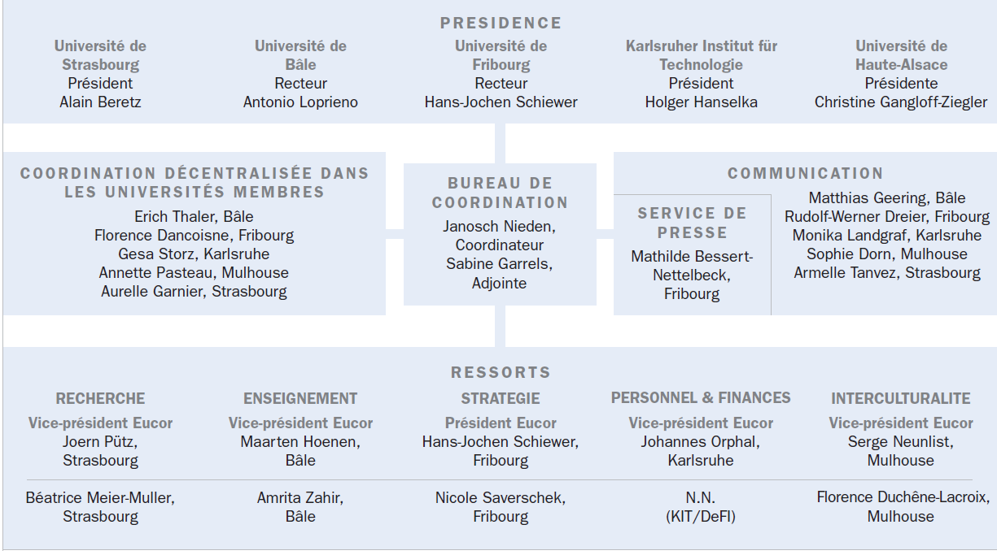
Eucor organisation

Slide 9
Thank you for your attention !
Janosch Nieden
Eucor - Coordinator
janosch.nieden@eucor-uni.org
Tél.: +33(0)3 68 85 85 68
8 rue des Écrivains 67000 Strasbourg France
www.eucor-uni.org

