Slide 1
Ulrich BOHNER
Chairman of Strasbourg Europe House (MESA)
Ex-secretary General, Congress of Local and regional Auhorities of the Council of Europe (2001-2008)
Tuesday 21 April 2015

Slide 2
Johannes MOISIO
President Task Force External Borders Association of European Border Regions
Tuesday 21 April 2015

Slide 3
The 6th AC21 Student Forum “The Role of Regional Cooperation in Support for Promotion and Protection of Human Rights and Environmental Projects”
Strasbourg 21. April 2015
Mr. Johannes Moisio
Chairman of AEBR Task Force of External Borders (TFEB)
Association of European Border Regions (AEBR)

Slide 4
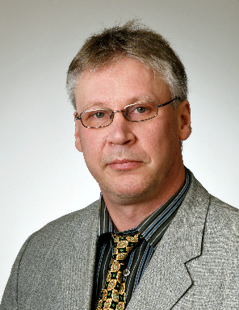
Johannes Moisio
Born in Helsinki 7. June 1960, M.Sc. (Eng), Logistics
1991-1993 research & lecturing, Lappeenranta University of Technology
1993 – 2000 Manager Export business (heating, piping, energy)
Regional Council of South Karelia: 2000 –
at present: Head of Cooperation with Interest Groups
Years 2004 and 2005 Director of Southeast Finland and St. Petersburg region office in Brussels
2007- Chairman of AEBR Task Force for External Borders (TFEB)

Slide 5
AGEG – AEBR - ARFE
1971 10 members (projects)
1980 30 (programmes, instruments)
2013 100 (concepts, recommendations)
≈ 200 European border areas
* Represents the interests of Cross-Border regions towards the
Council of Europe, the EU and the national Governments
* Has several thematic Task Forces
1997 10 founders
2014 20 active persons + random local participants
≈ 80 person mailing list and 116 in Facebook group
≈ 100 External border areas
+ networking, project generation, Youth Forum

Slide 6
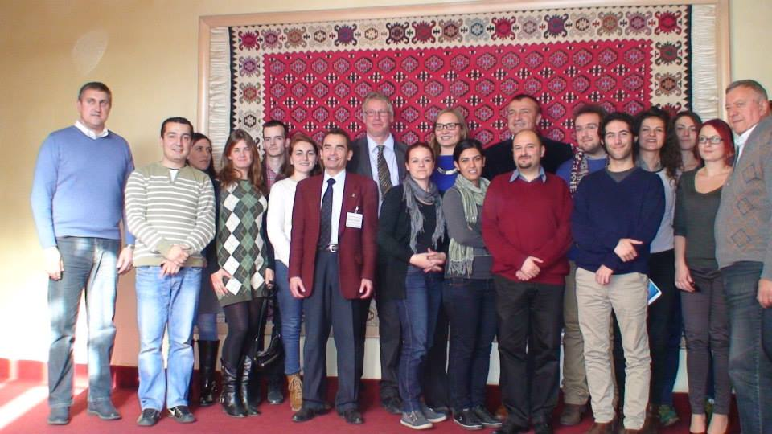
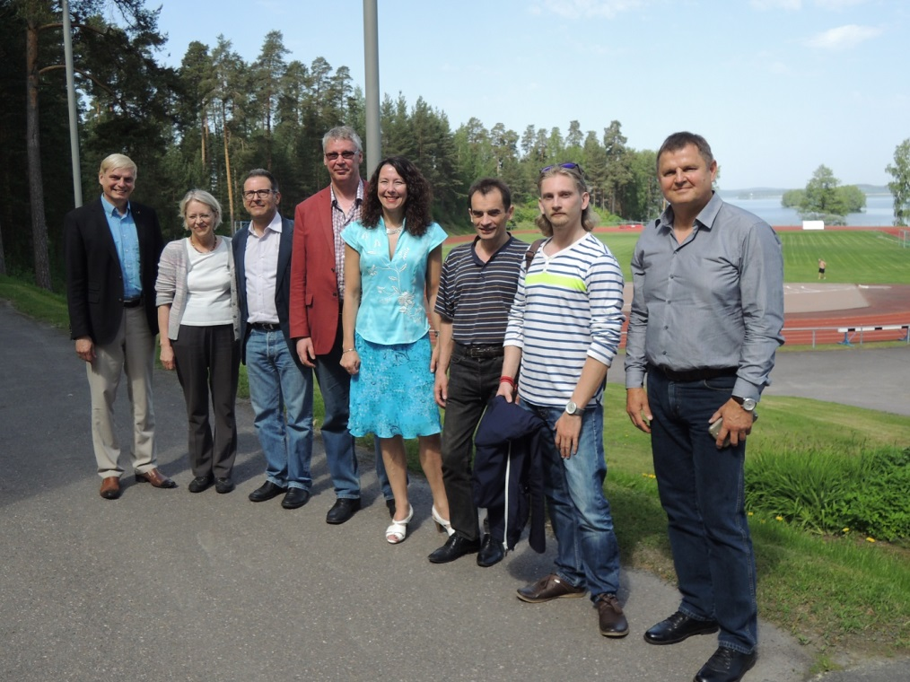
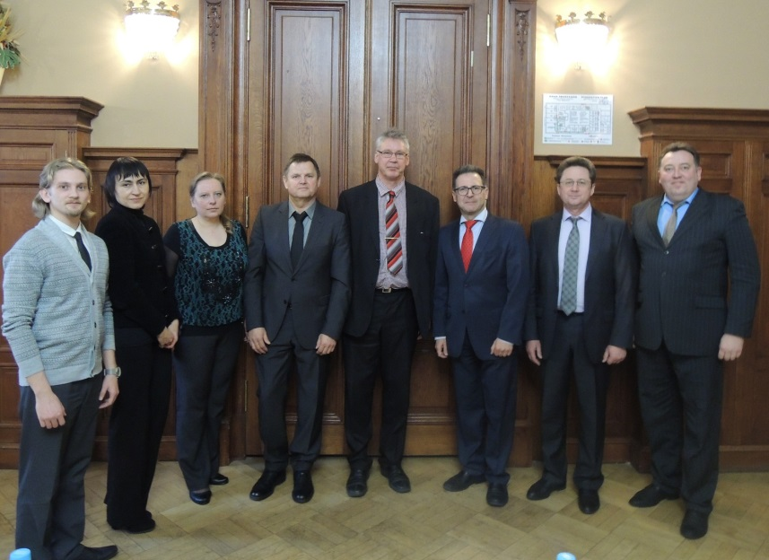
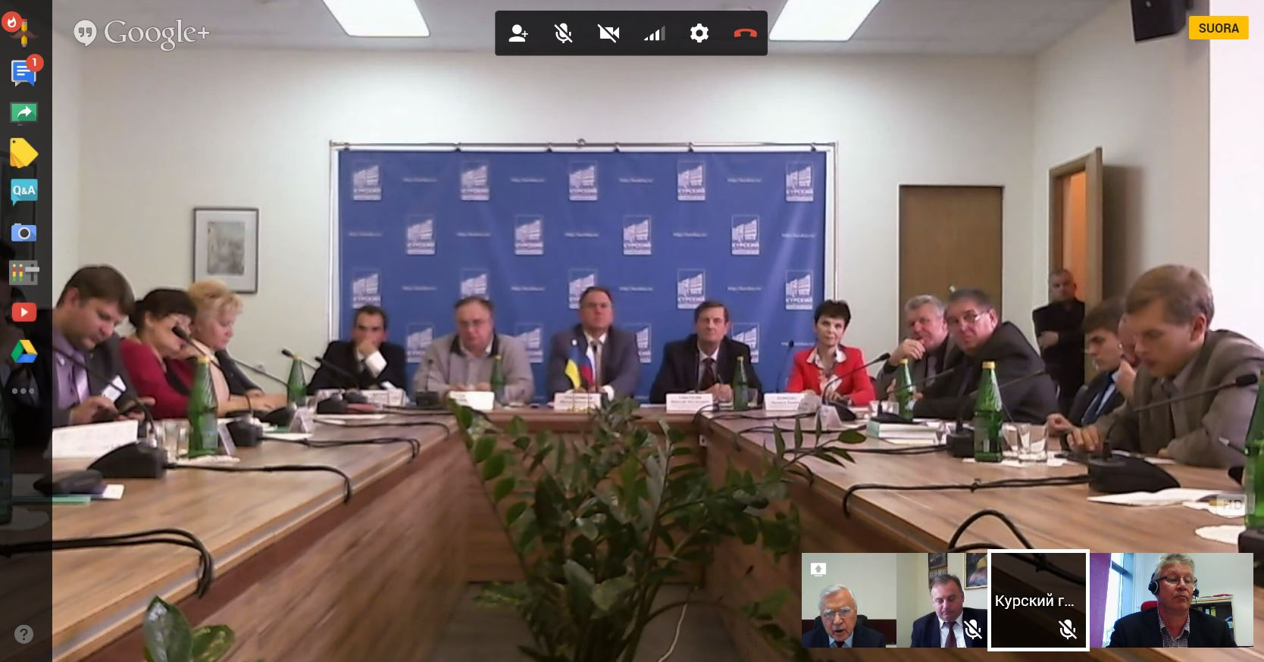
TFEB Youth Forum in Serbia 2014
Parikkala June 2014
St. Petersburg February 2014
Video conference hosted by Kursk October 2014

Slide 7
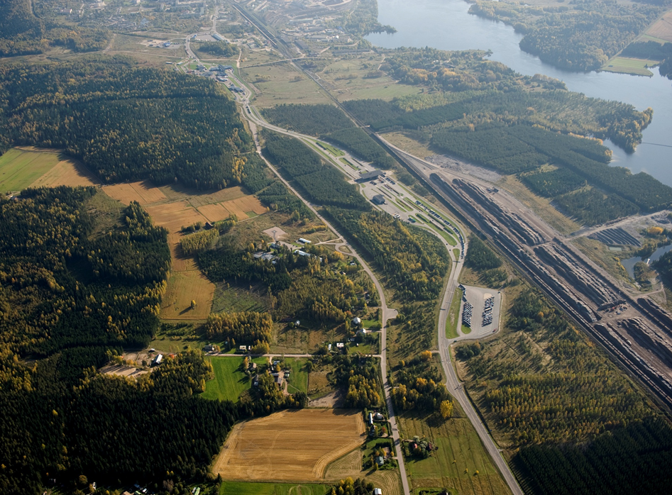
IMATRA –SVETOGORSK road and railway crossing points
Historically the
border was not
necessarily a physical barrier
It was a line indicating ownership
Trade across the border was widely accepted
– even welcomed
Yet, cooperation with strangers was at times suspicious (collaboration with the enemy)
People knew each other, strangers had to justify their visit

Slide 8
“Jungle” of Programmes and projects

Slide 9
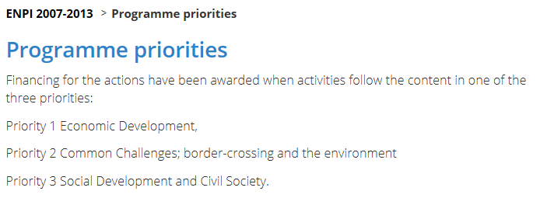
Programming approach - priorities in Programmes
Environment often named in the priorities while Human rights may remain
as a cross-cutting objective

Slide 10
Project applicant approach
Environment:
Interest for national as well as regional level
Direct benefits may be from local to regional
Often concrete border crossing impact
-> Possible project applicants from several levels
Human rights:
Interest for international organisations as well as GNOs
Benefits direct in target country and indirect in the neighbouring
Not necessarily direct border crossing impact
-> Limited interest to apply the project funding
After all – often own co-financing expected from the applicant

Slide 11
Joint applying approach
To make a multi-parner project requires
Preparations, discussions
Joint will
Joint timing of the project
Anticipating the obstacles (legislations, norms, visas, controls,
Permissions to work for the goals
-> Any obstacle may reduce the effect, even cease the project
Especially Human rights projects easily aim to produce recommendations
for the authorities. In this sense the quality of the partners and used experts
in essential

Slide 12
Joint applying approach
To make a multi-parner project requires
Preparations, discussions
Joint will
Joint timing of the project
Anticipating the obstacles (legislations, norms, visas, controls,
Permissions to work for the goals
-> Any obstacle may reduce the effect, even cease the project
Especially Human rights projects easily aim to produce recommendations
for the authorities. In this sense the quality of the partners and used experts
in essential

Slide 13
The hierarchy of requirements
-> Usually each level restricts the freedom in executing the project

Slide 14
Merci de votre attention! Thank you for your attention!
CONTACTS
Mr. Johannes Moisio:
Tel: +358 5 6163 119 Mobile: +358 400 154 382
E-mail: johannes.moisio@ekarjala.fi
MORE INFORMATION IN INTERNET:
AEBR: www.aebr.eu
AEBR Task Force of External Border, by joining Facebook group:
https://www.facebook.com/groups/AEBRTFEB/

